Slide 1
Frontend in the Industry
Week 12

Slide 2
Questions y’all submitted
- We can do a lot on the Frontend it appears, so what do Backend developers do at their basics?
- What are the job prospects like? I have always thought a job as a designer was rare but how true is that? And do most people come in as designers or move from engineering/marketing to design roles?
- Given that I’m not planning to be a designer, which industries desire design skills “on the side”?
- Do you have any advice for getting into Front-end for someone who is just starting out but about to graduate?
- What’s the biggest challenge you’ve faced going into design?
- What is the interview process like for frontend?
- What are certain products/projects you’ve specifically worked on and deployed?
- How does a front-end developer best deal with positioning and sizes, since a website must always be scalable throughout many devices?
- What are some of the hardest design interview questions?
-What are types of jobs in front-end programming?

Slide 3
Questions y’all submitted
- We can do a lot on the Frontend it appears, so what do Backend developers do at their basics?
- What are the job prospects like? I have always thought a job as a designer was rare but how true is that? And do most people come in as designers or move from engineering/marketing to design roles?
- Given that I’m not planning to be a designer, which industries desire design skills “on the side”?
- Do you have any advice for getting into Front-end for someone who is just starting out but about to graduate?
- What’s the biggest challenge you’ve faced going into design?
- What is the interview process like for frontend?
- What are certain products/projects you’ve specifically worked on and deployed?
- How does a front-end developer best deal with positioning and sizes, since a website must always be scalable throughout many devices?
- What are some of the hardest design interview questions?
-What are types of jobs in front-end programming?

Slide 4
Questions y’all submitted
We can do a lot on the Frontend it appears, so what do Backend developers do at their basics?
Do you have any advice for getting into Front-end for someone who is just starting out but about to graduate?
What is the interview process like for frontend?
What are certain products/projects you’ve specifically worked on and deployed?
How does a front-end developer best deal with positioning and sizes, since a website must always be scalable throughout many devices?
What are types of jobs in front-end programming?
What do you do when you hit a wall? I find it personally hard to progress and I find myself staring at whatever I have with no progress.

Slide 5
We can do a lot on the frontend it appears, so what do backend developers do?

Slide 6
From Front to Back
DevOps
SysAdmin
UI/UX, Design
Full Stack Developer
Front
Back
Front End Developer
Back End Developer

Slide 7
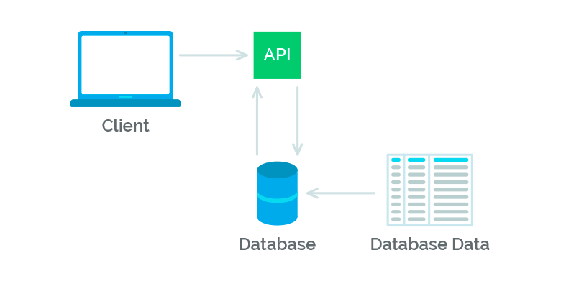

Slide 10
Backend
Work with databases
Work with APIs/servers
Connect with frontend
Underlying functionality
Basically nothing is visual

Slide 11
What is the interview process like for frontend?

Slide 12
Interview Process
(coding challenge) → (behavioral phone screen) → technical/coding phone screen → onsite (3-5 rounds of coding and behavioral interviews)

Slide 13
Startup vs Big Tech
Small startup
Specific tech stack
Coding challenge (long-form)
Create a React app in 3 days
Get in and get going right away with less mentorship
Expect lots of experience
Big Tech
General DS&A
Coding challenge (short-form)
Slow, large complex and mature systems, lots of mentorship or whole bootcamps
Take risks on 0 experience

Slide 14
Specifically, Frontend Interviews
HTML, CSS, JavaScript
Create a skeleton of…
FB profile page header
Twitter feed
Advantages and disadvantages of JS
Call, apply, this, equal signs, etc
Scoping, environments
React on your resume?
Be prepared to be asked about it
Be prepared to code within it

Slide 15
Questions to Ask an Engineer
Learn more about what their role
Ask about what parts of the product they work on
How much they contribute to the company/team
Learn more about them
How did they get to where they are today?
What they’re interested in about the product
Learn more about engineering culture at their company
Overlapping teams (design-frontend-backend)
Feature-based? Project-based? Product-based?
Agile? SCRUM? Lots of meetings? Mentorship?
Ability to work on side projects and tools

Slide 16
What types of jobs are in frontend?

Slide 17
Design-Frontend
More design-y and creative
Overlap with design team and product managers
Lots of CSS

Slide 18
Frontend-Fullstack
More code-y and technical
Connect the pipes between front and backend
Lots of JavaScript

Slide 19
Combination
Most frequently, frontend is more like fullstack
But they work more closely with design teams/product managers

Slide 20
Company types
Startup
Mid-sized company
Large company

Slide 21
Freelance
Experience-reliant
Creating custom websites
Creating apps
Check what scope actually is
Are you being made to design too?
Does the project actually require backend?
Flexibility and remote work

Slide 22
Do you have any advice for getting into frontend for someone who is just starting out but about to graduate?

Slide 23
Getting started
No experience?
Personal projects
Make websites
Create clones
Try new frameworks
Get referrals, connections
Start somewhere, transition
Create opportunity
Get involved

Slide 24
Getting started
Learn React lol*
*overrated but useful

Slide 25
Believe in yourself
Notes:
Omg this is so cute i forgot to mention this in mine ::(((( -jemma

Slide 26
What are certain products/projects you’ve specifically worked on and deployed?

Slide 27
WDD Staff is Amazing
Jemma: Adobe (Lightroom)
Seth: Slack
Heidi: PayPal
Nicole: FiveStars
Myles: Soon, FiveStars
Jessie: Soon, FB
Brenda: Soon, Adobe (my GitHub)
Linus: Soon, Repl.it (also everything in the universe)
Alum: Google, FB, LinkedIn

Slide 28
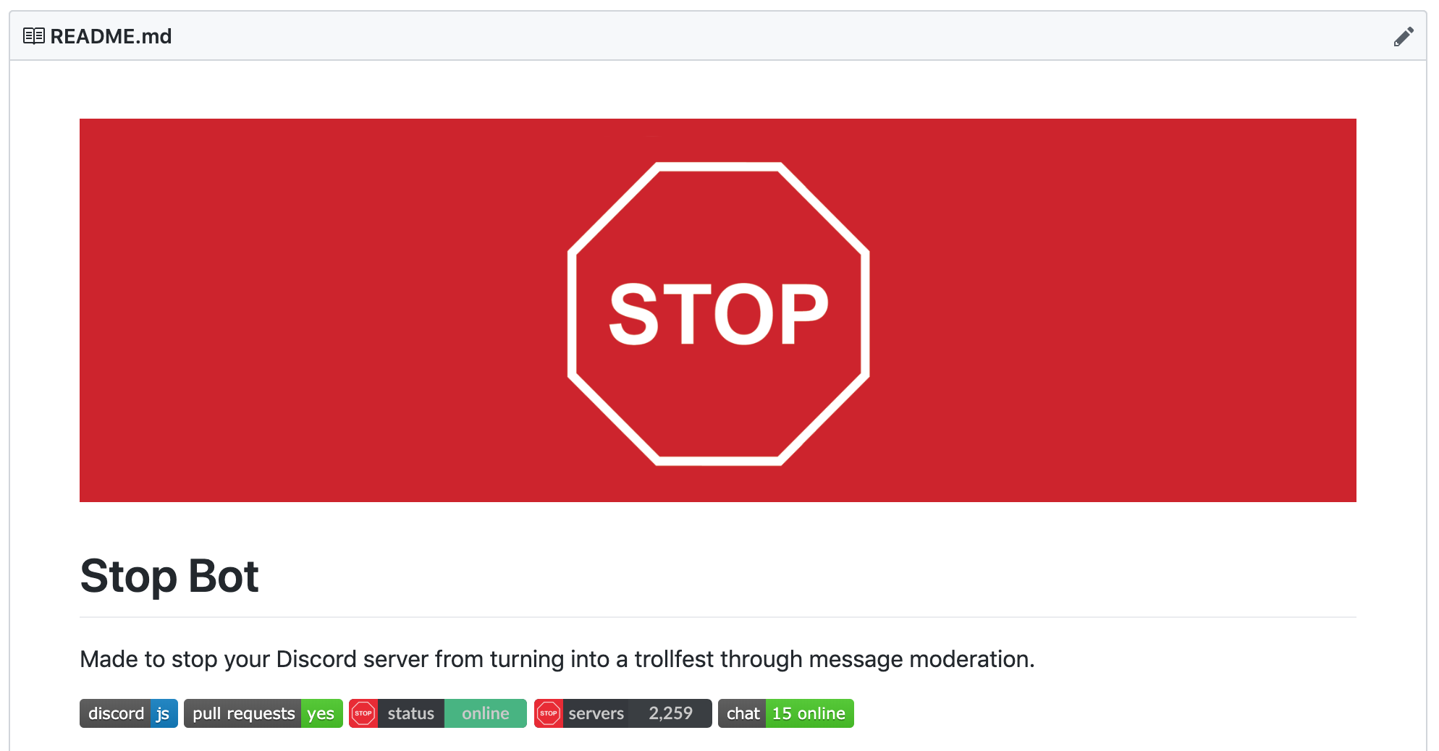
Discord Bot
https://github.com/brendacs/stop-bot

Slide 29
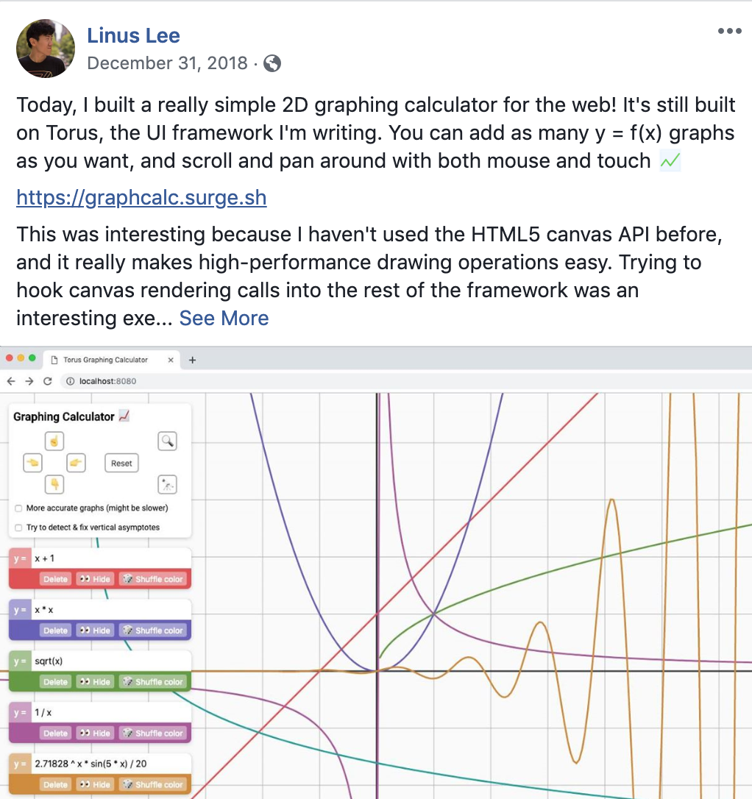
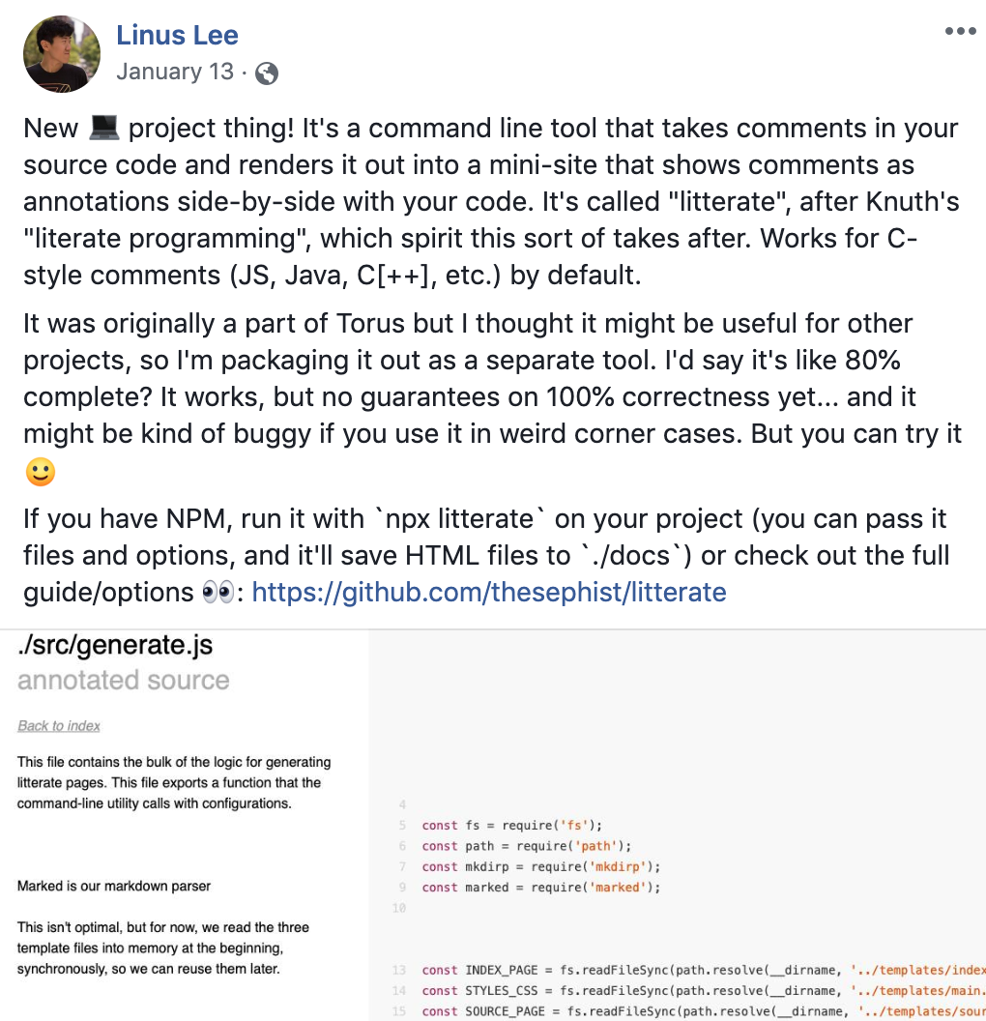
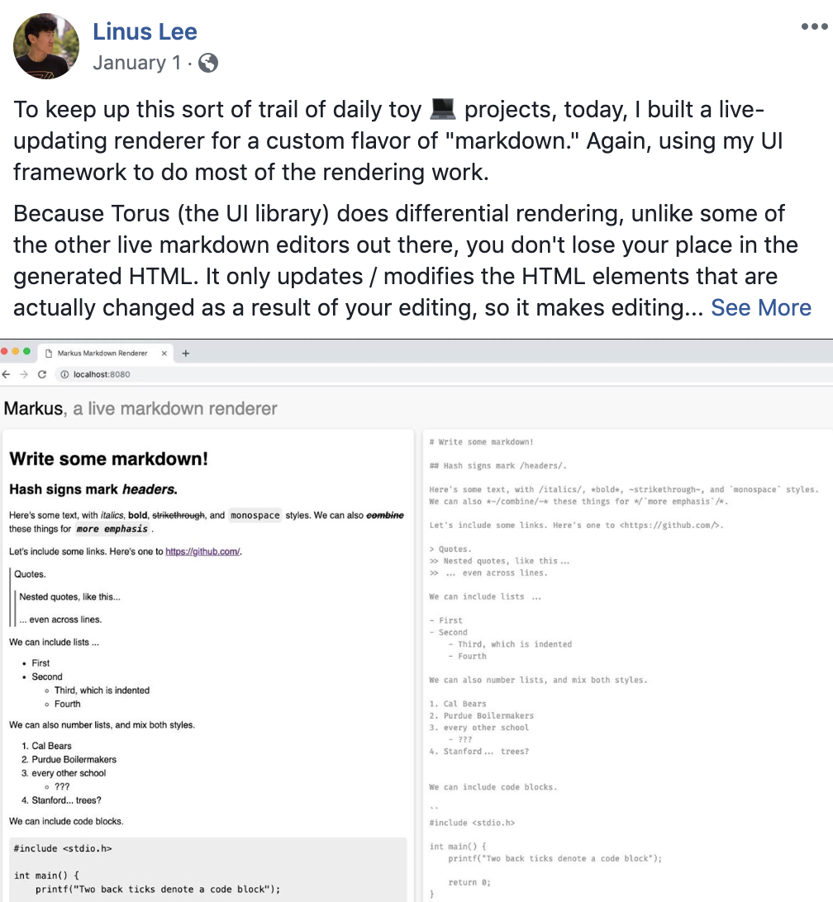
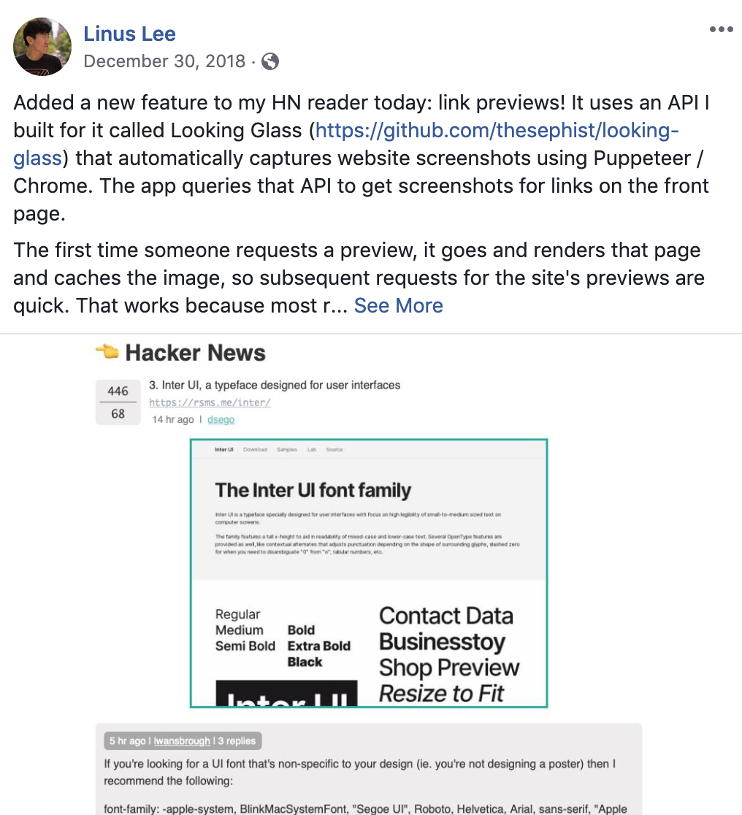
Linus’ Projects

Slide 30
How does a frontend developer best deal with positioning and sizes, since a website must always be scalable throughout many devices?

Slide 31
Responsiveness
Best practices
Flexbox, CSS grids, media queries
Percentages, vh, vw, em instead of px
Planning ahead while designing, mobile-first design
Industry
Think ahead, plan layout with designers
Automated unit testing
Automated end to end testing
Dedicated QA (Quality Assurance) teams
Test on various browsers and resolutions manually

Slide 32
A lesson learned quickly on the frontend:
Every year, you learn a new framework or two or three
Every year, you catch up with new device resolutions
Every year, you have to Google new errors and bugs
Every year, CSS and JS changes or updates and conventions change
You take a nap and suddenly, you are working on legacy code 😱

Slide 33
In conclusion,
They do the best they can

Slide 34
Queue&A (ask us literally anything)

